Slide 1
Complex Features: Still_Creating
Alec Day, Jeremy Ruebush, Alex Berryhill

Slide 2
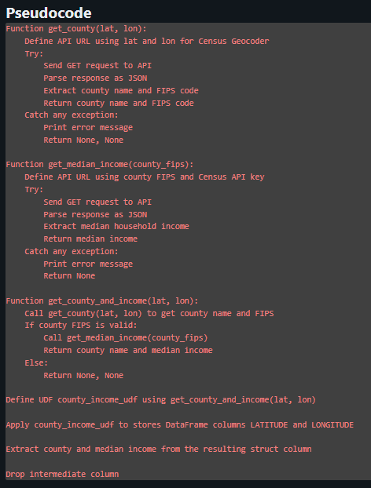
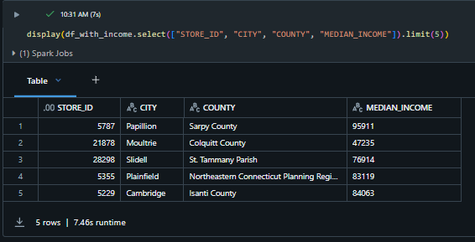
Median Income in Counties
By: Alex Berryhill
This feature is the Median income of the county that the convenience store sits in. This will be wildly important for our model for predicting an item that will sell well in similar areas. Using this we can say in a similar neighborhood more people buy certain things. It starts by taking the data frame that holds all of the stores with the latitude and longitude, then I use a Geocoding API to get the county name, but more importantly the fips. Using the FIPS I can get the median income of a specific county using the census API.

Slide 3
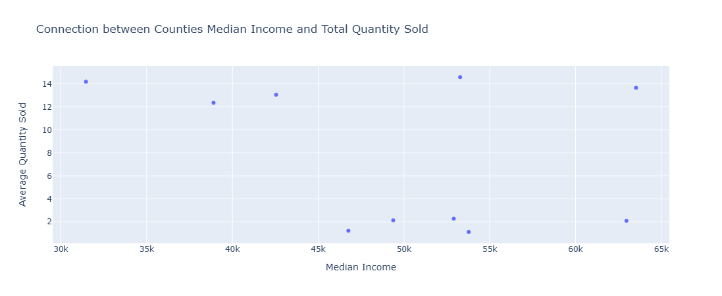
Alex Berryhill (Continued)

Slide 4
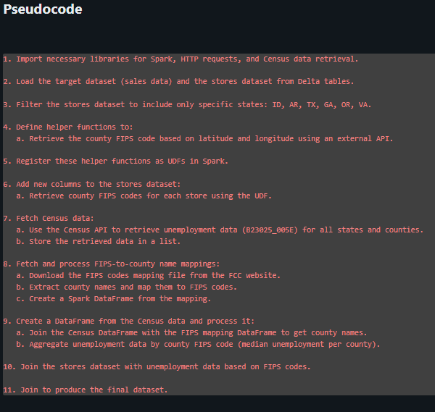
Alec Day: The Effect of Unemployment on Sales
I retrieved unemployment data at the census tract level from the U.S. Census API and aggregated it to find the median number of unemployed people per county. Using an API, I obtained county FIPS codes for each store based on their latitude and longitude, then joined the aggregated unemployment data with the stores dataframe on the FIPS code. Finally, I linked this enriched store data to the target dataset by store ID, ensuring that each store's weekly target data included relevant unemployment statistics.

Slide 5
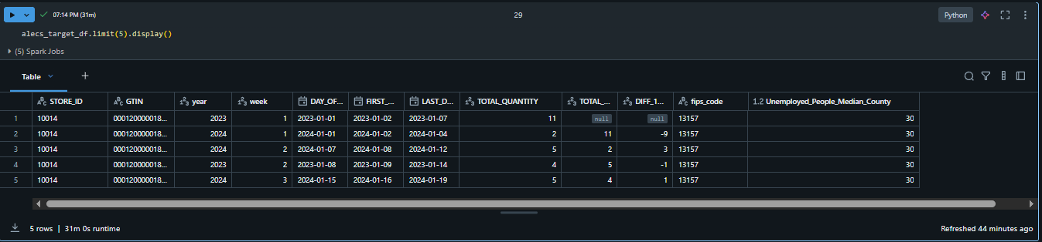
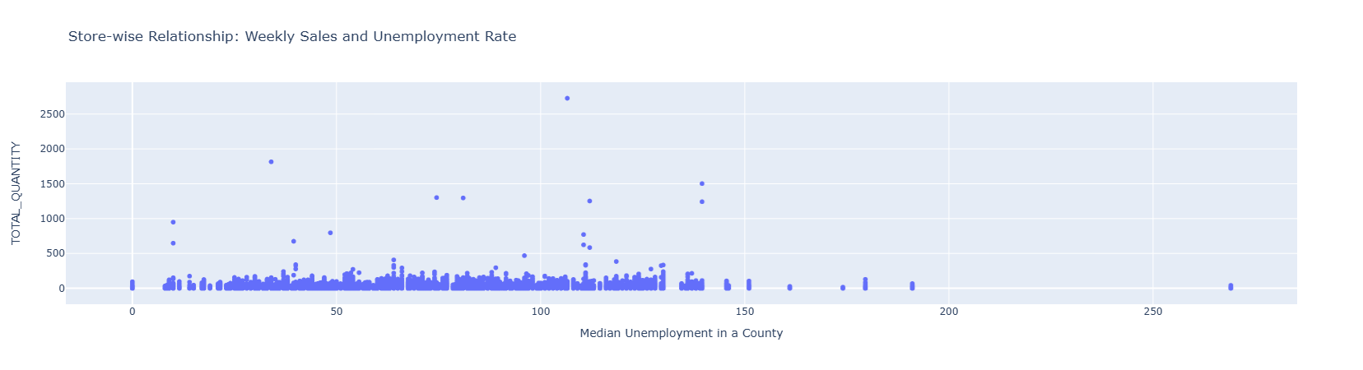
Alec Day (Continued)

Slide 6
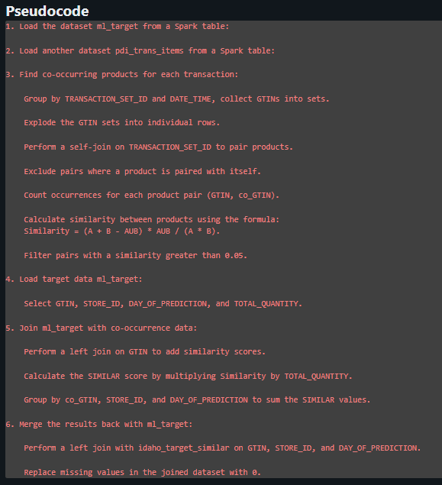
Jeremy Ruebush: Item Similarity Scores
The feature I created generates a similarity score for products sold in the previous week by analyzing past transaction sets and identifying similarities between products sold in the same transaction.
It calculates the correlation between products by determining the probability that two products appear in the same transaction, divided by the product of the probabilities that each product appears in a transaction individually: P(AUB)/(P(A)*P(B)). This results in a similarity score between 0 and 1 for each product pair.
I then used these similarity scores, multiplied them by the quantities sold in the previous week, and summed the resulting values to obtain a single similarity value of products sold the previous week.

Slide 7
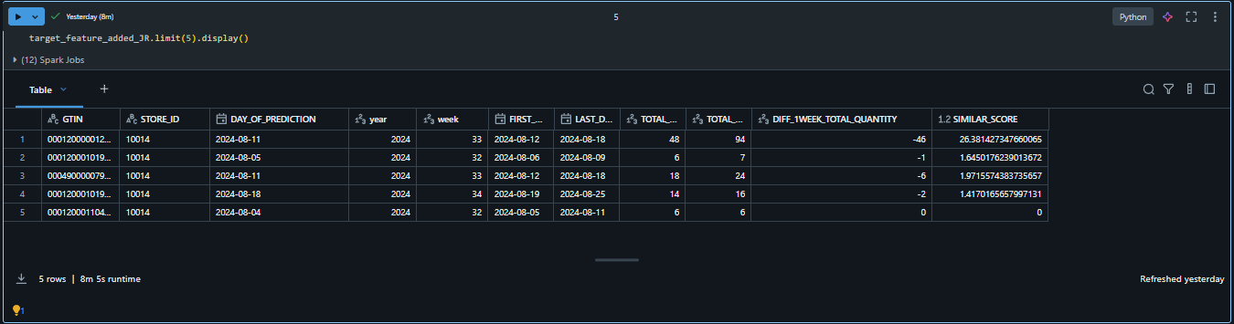
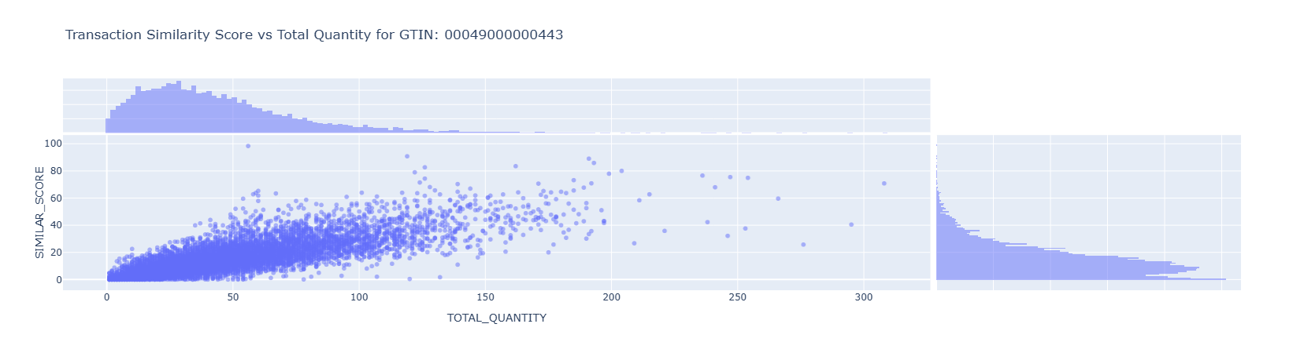
Jeremy Ruebush (Continued)

Slide 8
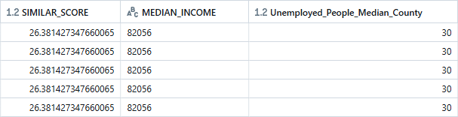
Combined Table

Slide 9
